Slide 1
UHF TRX (new)
Functions
PBS
WBS
Performance
RAS
Schedule

Slide 2
Functions
Purpose: To develop the new Transceiver are to achieve the same performance, data rate and low power consumption at a lower cost than the commercial UHF TRX.
Functions: (Same as commercial UHF TRX)
Receive uplink command from the ground station (GS), and send the received command to the onboard computer (OBC)
Transmit mission or payload data via downlink to the GS.
Transmit continuous wave (CW) beacon to the GS

Slide 3
PBS
Satellite
1.1
Missions
1.1.2
New UHF TRX
1.1.2.3
GMSK AX.25 Modulator
1.1.2.3.1
GMSK AX.25 Demodulator
1.1.2.3.2
CW BEACON Transmissions
1.1.2.3.3
New COM EPS
1.1.2.3.4

Slide 4
WBS
Satellite
1.1
Missions
1.1.2
New UHF TRX
1.1.2.3
GMSK AX.25 Modulator
1.1.2.3.1
GMSK AX.25 Demodulator
1.1.2.3.2
CW BEACON Transmissions
1.1.2.3.3
Test
Test
Test
New COM EPS 1.1.2.3.4
Test
Procurement
Assemble

Slide 5
Performance
GMSK AX.25 Modulator
Operating Frequency: 437.375 MHz
Output Power: 800 mW-700 mW (29dBm -28.45 dBm)
Data Speed: 4800 bps
Modulation: GMSK
Packet Format: AX.25
GMSK AX.25 Demodulator
Operating Frequency: 435.313 MHz
Data Speed: 4800 bps
Modulation: GMSK
Packet Format: AX.25

Slide 6
Performance
CW BEACON Transmissions
Operating Frequency: 437.375 MHz
Output Power: 100 mW (20dBm)
Data Speed: 20 wpm
Modulation: Morse Code
New COM Internal EPS
Input Voltage: 3.3 V – 5V
Input Current: GMSK TX (<500 mA), GMSK RX (<100 mA), CW TX (<100 mA)
Output Voltages: 3.3 V, 5V
OCP: @ 2 A

Slide 7
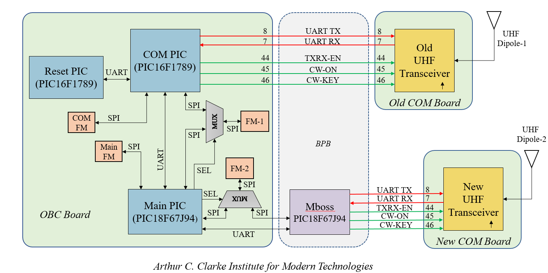
Block Diagram

Slide 8
RAS
SR 1.1 – Satellite shall be able to receive uplink command from ground station
ID | Design Requirements | ID | Verification requirement | Verification method
DR 1.1.1 | Antenna shall be dipole that receives uplink command at 435 MHz. | VR 1.1.1.1 | Get the S11 parameter of the antenna. | • Use simulation tool (e.g. CST, HFSS). • Use Vector Network Analyzer (VNA) at anechoic chamber test.
 |  | VR 1.1.1.2 | Measure received signal power at the antenna. | • Use Spectrum Analyzer (SA) at anechoic chamber test. • Use SA at Long Range Test (LRT).
DR 1.1.2 | Modulation shall be GMSK at 4800 bps data rate. | VR 1.1.2.1 | Confirm the output waveform at the transceiver (TRX). | • Use oscilloscope to check the waveform.
DR 1.1.3 | Frame format shall be AX.25 Protocol. | VR 1.1.3.1 | Determine the packet error. | • Send pre-defined data and inspect the received data for errors.
DR 1.1.4 | New COM MCU shall send the command to OBC through UART. | VR 1.1.4.1 | Check UART communication between new COMM MCU and OBC. | • Compare new COMM MCU transmit data and OBC received data. • Count packets successfully received vs. transmitted at controlled environment and at LRT
 |  | VR 1.1.4.2 | Conduct uplink success rate test. | • Count packets successfully received vs. transmitted at controlled environment and at LRT.
 |  | VR 1.1.4.3 | Conduct link budget computation. | • Compute for theoretical losses and gains at every critical points. • Measure the losses and gains at every critical points at controlled environment, and at LRT.

Slide 9
RAS
SR 1.2 – Satellite shall be able to transmit telemetry and mission data to ground station.
ID | Design Requirements | ID | Verification requirement | Verification method
DR 1.2.1 | COM MCU shall receive the telemetry data from OBC through UART. |  | Check UART communication between OBC and COMM MCU. | • Compare OBC transmit data and COMM MCU received data.
DR 1.2.2 | Modulation shall be GMSK at 4800 bps data rate. |  | Confirm the output waveform at the transceiver (TRX). | • Use oscilloscope to check the waveform.
DR 1.2.3 | Frame format shall be AX.25 Protocol. | VR 1.2.3.1 | Determine the packet error. | • Send pre-defined data and inspect the received data for errors.
DR 1.2.4 | Antenna shall be dipole and receives downlink command at 437.375 MHz. | VR 1.2.4.1 | Get the S11 parameter of the antenna. | • Use simulation tool (i.e. CST, HFSS). • Use VNA at anechoic chamber test.
 |  | VR 1.2.4.2 | Measure transmitted signal power at the antenna. | • Use SA at anechoic chamber test. • Use SA at LRT.
 |  | VR 1.2.4.3 | Conduct downlink success rate test. | • Count packets successfully transmitted vs. received at controlled environment and at LRT.
 |  | VR 1.2.4.4 | Conduct link budget computation. | • Compute for theoretical losses and gains at every critical points. • Measure the losses and gains at every critical points at controlled environment, and at LRT.

Slide 10
RAS
SR 1.3 – Satellite shall be able to send CW beacon.
ID | Design Requirements | ID | Verification requirement | Verification method
DR 1.3.1 | CW shall contain housekeeping data. | VR 1.3.1.1 | Check read data. | • Check read display data.
SR 1.4 – new TRX shall survive space environment.
ID | Design Requirements | ID | Verification requirement | Verification method
DR 1.4.1 | New TRX shall be able to survive thermal test in the range of -10C to 45C. | VR 1.4.1.1 | Shall confirm the new TRX can survive thermal test. | • COMM operational test in laboratory.
SR 1.5 – new TRX shall survive launch environment.
ID | Design Requirements | ID | Verification requirement | Verification method
DR 1.5.1 | New TRX shall be able to survive vibration test. | VR 1.5.1.1 | Shall confirm the new TRX can survive vibration test. | • Vibration Test.

Slide 11
Schedule
Schedule |  | 2023 |  |  |  |  |  |  |  |  |  |  |  | 2024
 | Dec | Jan | Feb | Mar | Apr | May | Jun | Jul | Aug | Sep | Oct | Nov | Dec | Jan | Feb
MDR
Designing and bread board model, Programming
BBM procurement
PDR
EM development
CDR
Integration with other satellite subsystem
Space environment tests
FM development and LRT

